Slide 1
SMART CLASSROOM MONITORING
21BEC1156 Aadhityaa S 21BEC1287 Sanjay Carmel 21BEC1434 Antony Bacil

Slide 2

INTRODUCTION
Smart classroom monitoring is an innovative solution that revolutionizes the way we monitor student attendance and real-time performance. This groundbreaking technology is reshaping the landscape of education by introducing enhanced efﬁciency and effectiveness. Moreover, this system efﬁciently tracks the number of students present in the classroom, leading to automatic adjustments such as turning off lights and fans, further promoting energy conservation and sustainability.

Slide 3

BENEFITS OF SMART CLASSROOM MONITORING
Improved Performance Monitoring
Increased Efﬁciency
Enhanced Attendance Tracking Time Savings: Allows teachers to focus more on teaching and engaging with students.
Improved Student Engagement: Makes adjustments to their learning strategies, fostering a sense of ownership and motivation

Slide 4

ATTENDANCE TRACKING
Smart classroom systems employ RFID (Radio Frequency Identiﬁcation) to automate
attendance. As students enter the classroom, the attendance system instantly registers their presence, providing accurate and up-to-date attendance records.
This systems generate comprehensive attendance reports and analytics

Slide 5
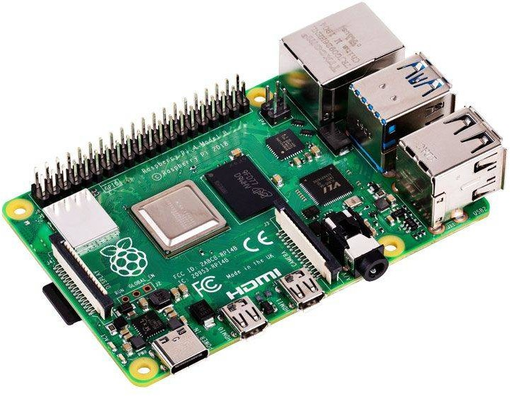
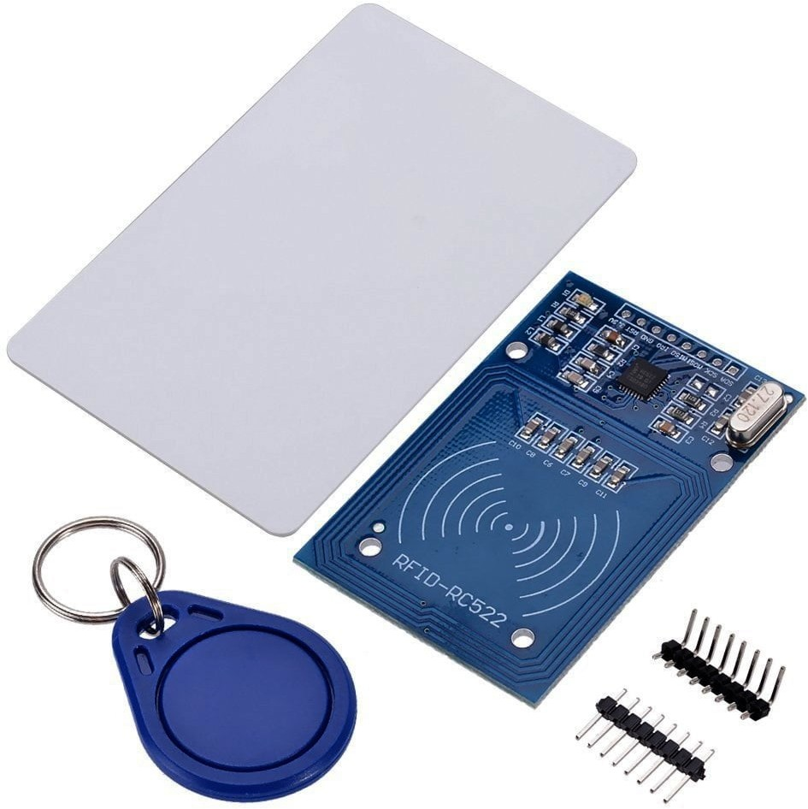
COMPONENTS
L. Rasberrry Pi
2. ESP32
3. ESP8226
RFID
CT Clamp
IR Sensor

Slide 6
CONCLUSION
In conclusion, smart classroom monitoring is a revolutionary solution that is transforming the education landscape. By leveraging technology and automation, it offers numerous beneﬁts for tracking student attendance, monitoring performance in real- time, and optimizing classroom resources

Slide 7
THANKYOU
Do you have any questions?

